Slide 1
Completing LinkedIn Learning Online Microsoft Tutorials

Slide 2
Coventry University students have LinkedIn Learning accounts
Click the Tutorial link to take you to the LinkedIn Learning page
Click the Sign in button in top right hand corner
Use your student email for the Single sign-in

Slide 3
Complete the course
Watch the videos and complete the quizzes
Completed activities will have a green tick

Slide 4
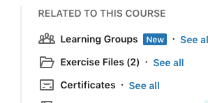
Get your certificate
Click on the Certificates link to download your certificate when you’ve completed the course
Paste a screenshot of this into your Coursework log

